Slide 1
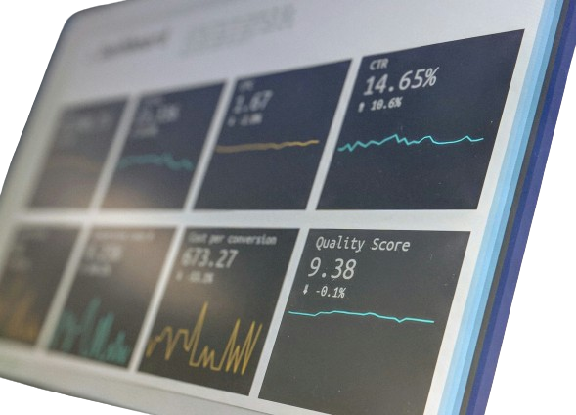
YouTube Songs Analysis
Gloria Ayoola
MIP-DA-10

Slide 2
